Slide 1
Black-Box System Analysis and Control Design for Autonomous Ship Stabilization
MTHE 393 - Group 02
Nolan Verboomen, Jack Switzer, Elliott Thoburn & Eiqan Ahsan
Notes:
Eiqan

Slide 2
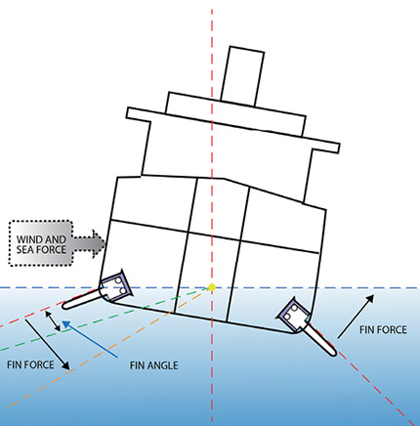
Why is it Worth Solving?
Ships experience roll motion in rough waters, leading to passenger discomfort, cargo instability, and increased fuel consumption.
A stabilization system enhances safety, efficiency, and environmental sustainability.
Notes:
Nolan

Slide 3

Stakeholders
Shipping Companies
Port Authorities
Passengers
Environmental Agencies
Notes:
Nolan
Companies: Reduce operational costs by improving fuel efficiency and reducing cargo damage.
Port Authorities: Increase reliability of maritime schedules.
Passengers: Improve travel comfort and reduce seasickness.
Environmental Agencies: Reduce emissions by minimizing unnecessary fuel consumption.

Slide 4
Input/Output
Input | Output
Roll angle from gyroscopic sensors | Stabilizer actuation
Single Input, Single Output
Notes:
Nolan
Stabilizer Actuation = (adjustments in ballast tanks, fin angles, or gyroscopic stabilizers)

Slide 5
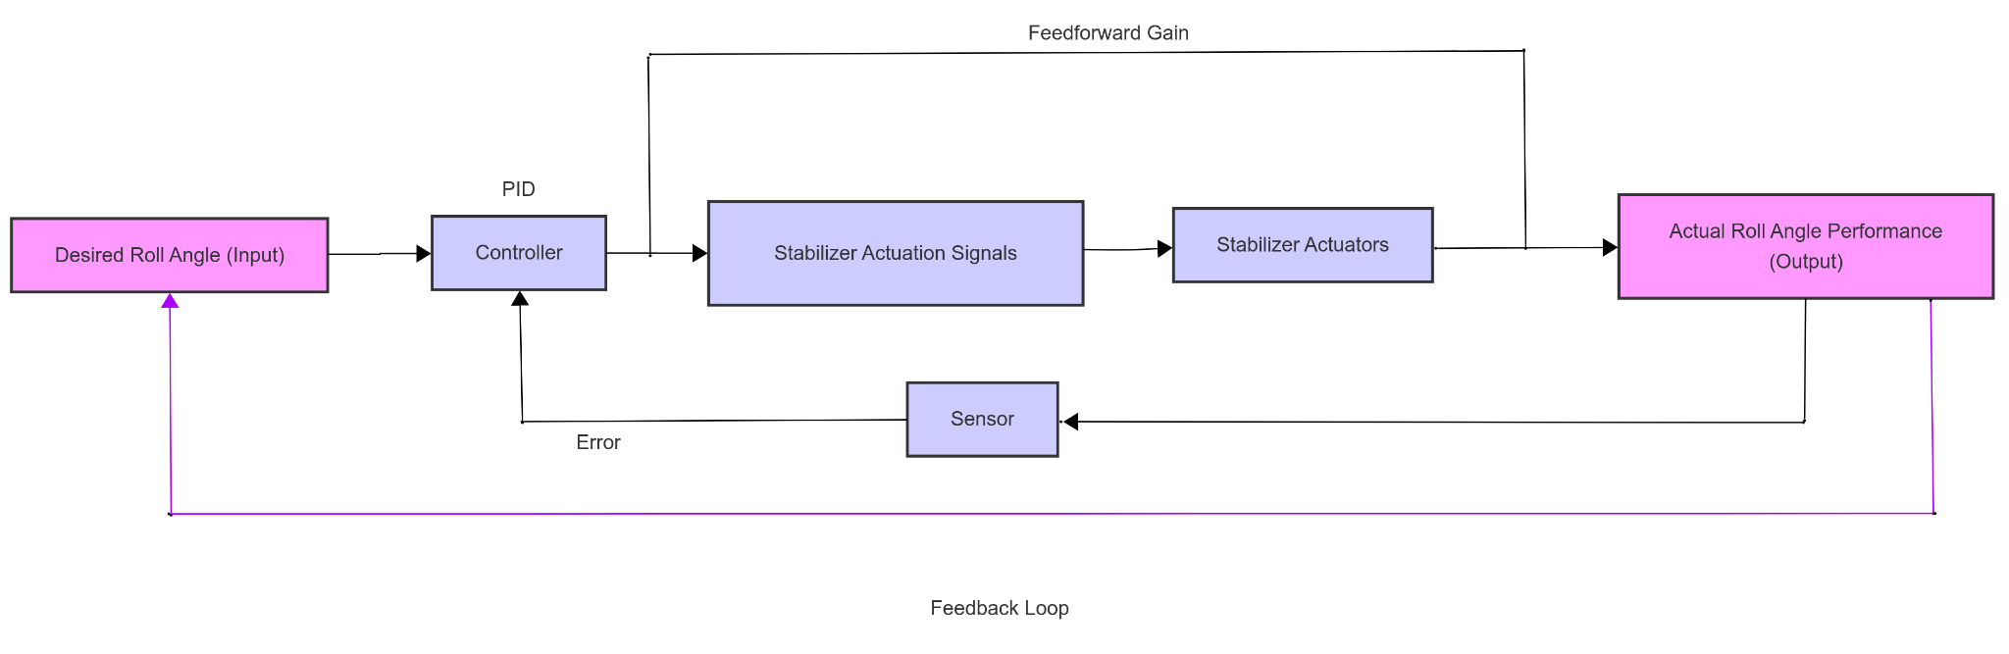
System Diagram
Figure 1: System Diagram Showing Flow from Input to Output
Notes:
Nolan
Stabilizer Actuation = (adjustments in ballast tanks, fin angles, or gyroscopic stabilizers)

Slide 6
Validating LTI
Tested using denoised sample signals to represent harmonic class input/output signals
Linearity tested through homogeneity and superposition.
Time-invariance tested by shifting input signals and comparing system responses.
Notes:
Elliot

Slide 7
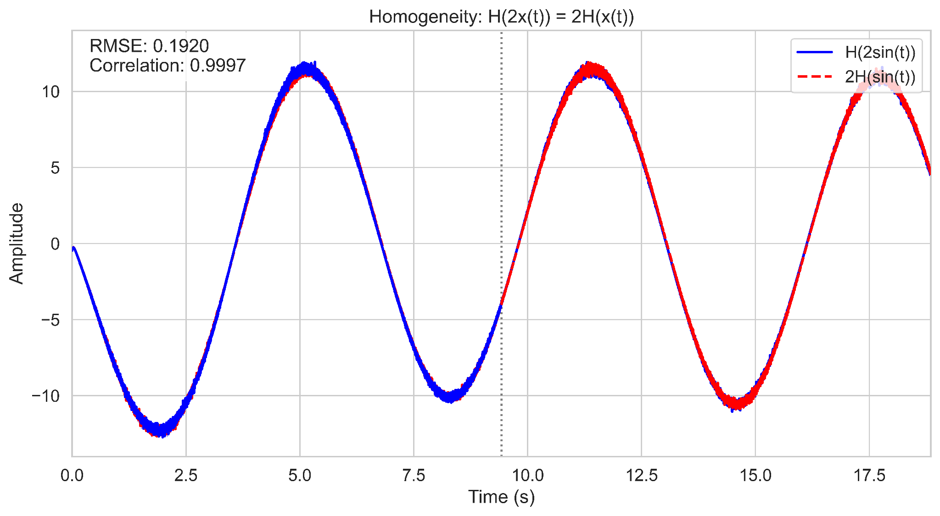
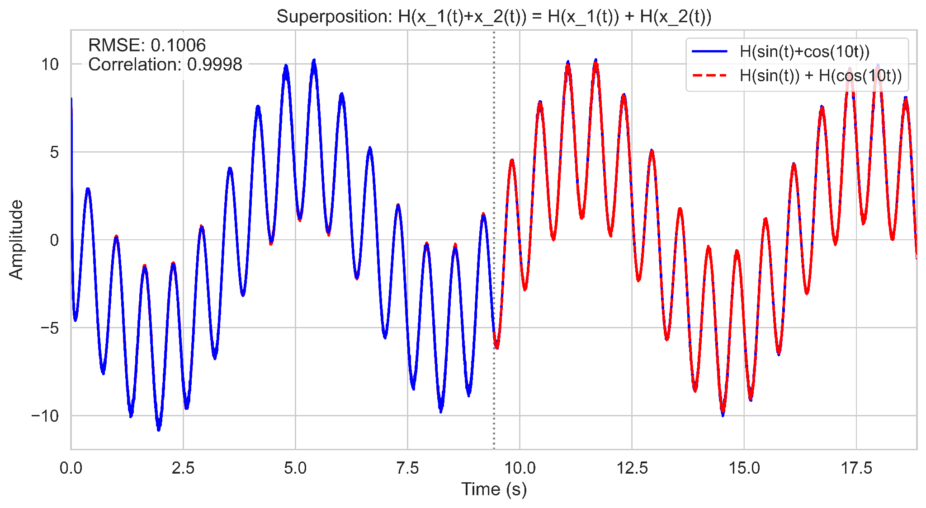
Linearity
2 x Output of Sin(t) vs Output 2*Sin(t)
Output of sin(t)+cos(10t) vs output of sin(t) + Output of cos(10t)
Figure 2: Homogeneity test
Figure 3: Superposition test
Notes:
Elliot

Slide 8
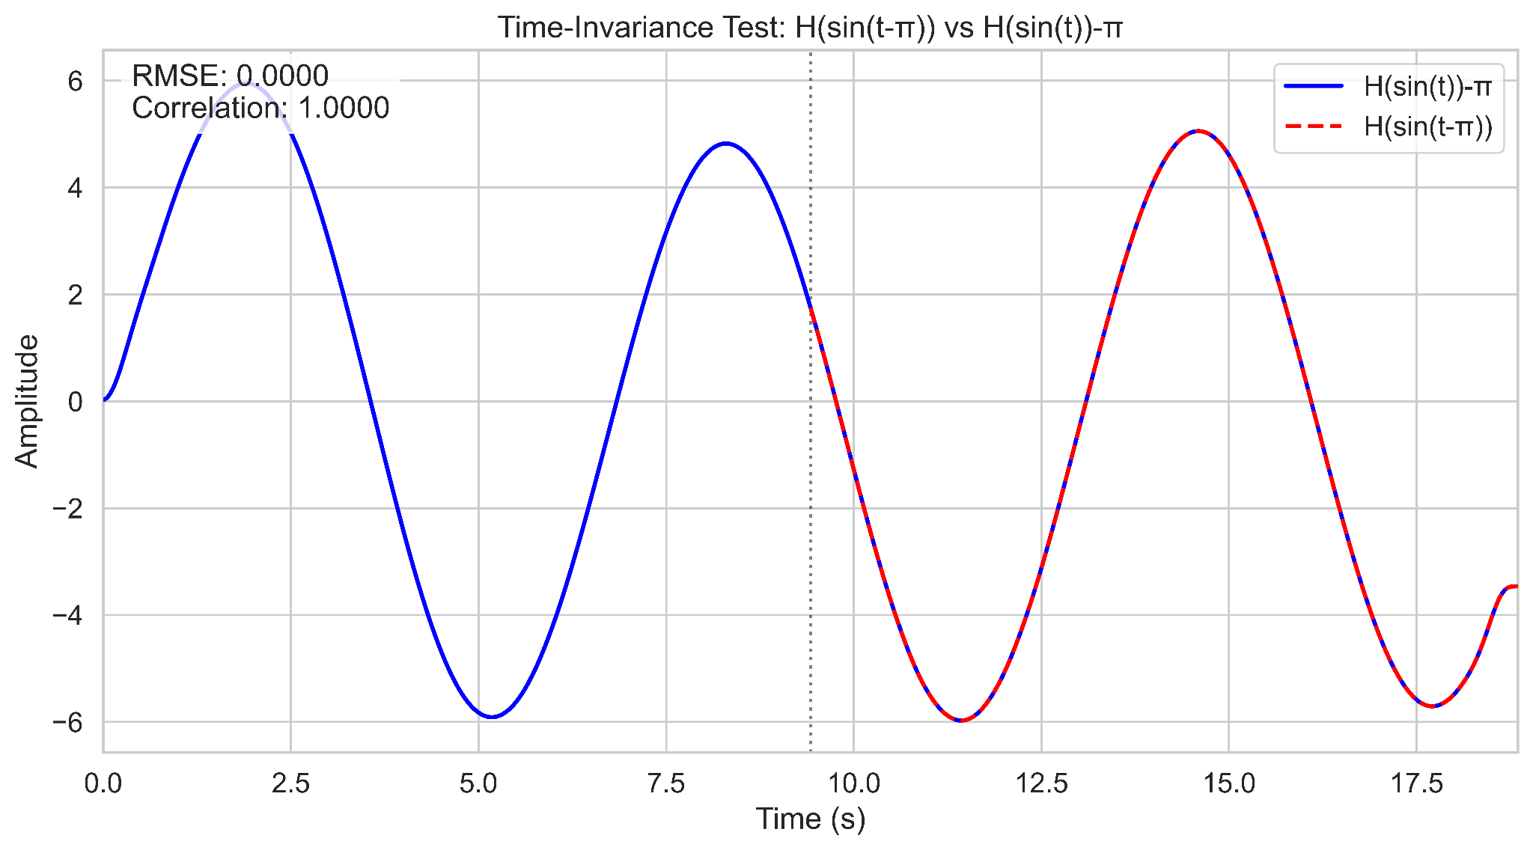
Time Invariance
Output of sin(t) shifted by -pi and sin(t-pi)
Figure 4: Time-invariance test
Notes:
Elliot

Slide 9
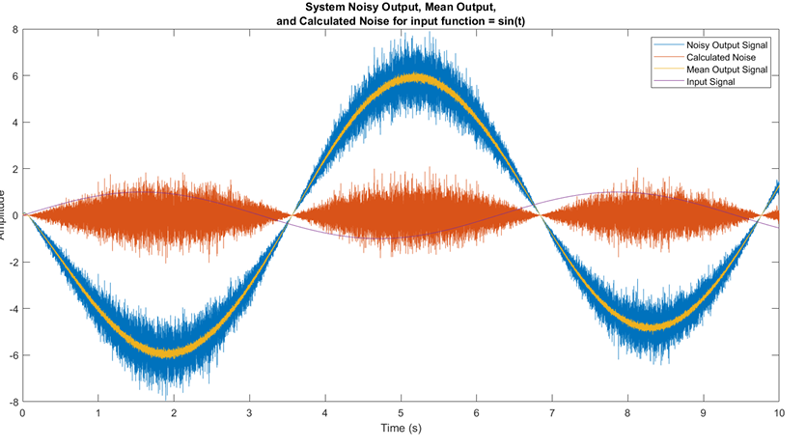
Removing System Noise
System Noisy Output, Mean Output, and Calculated Noise for input function = sin(t)
Figure 5: System Noise Visualization
Notes:
Elliot

Slide 10
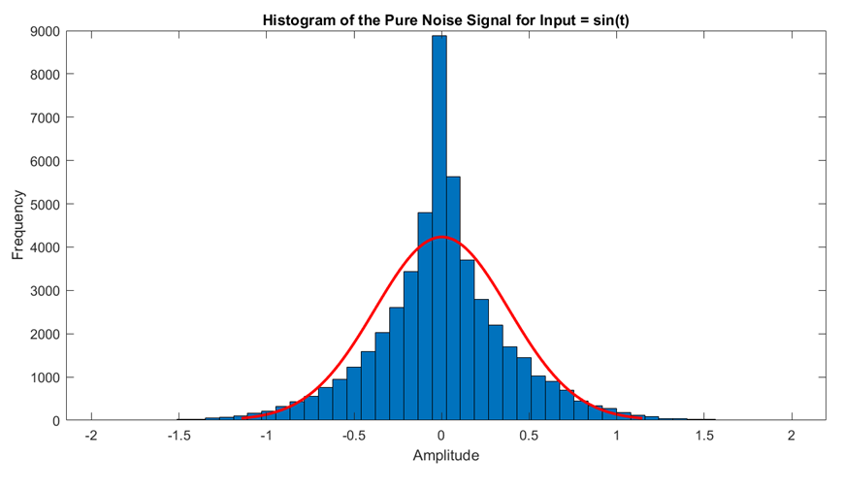
Histogram of the Pure Noise Signal for Input = sin(t)
Figure 6: Pure Noise Histogram for g(t) = sin(t). Mean = 0.0015
Notes:
Elliot

Slide 11
Removing System Noise
Attempted many filter types: low-pass, high-pass, Gaussian smoothing, Chebyshev, and moving-average filters.
Best approach was to simply gather 20-100 signals and average them out (pointwise)
Notes:
Elliot

Slide 12
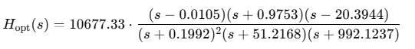
Bode Plot & Transfer Function
Collected data for a range of frequencies (10e^-3 to 10e^4 Hz).
Averaged 20 signals over 50 trials for each frequency, 6 periods per signal.
Optimized to minimize RMSE after imprecise mathematical estimates
Transfer function:
System behavior analyzed through magnitude and phase plots.
Notes:
Jack

Slide 13
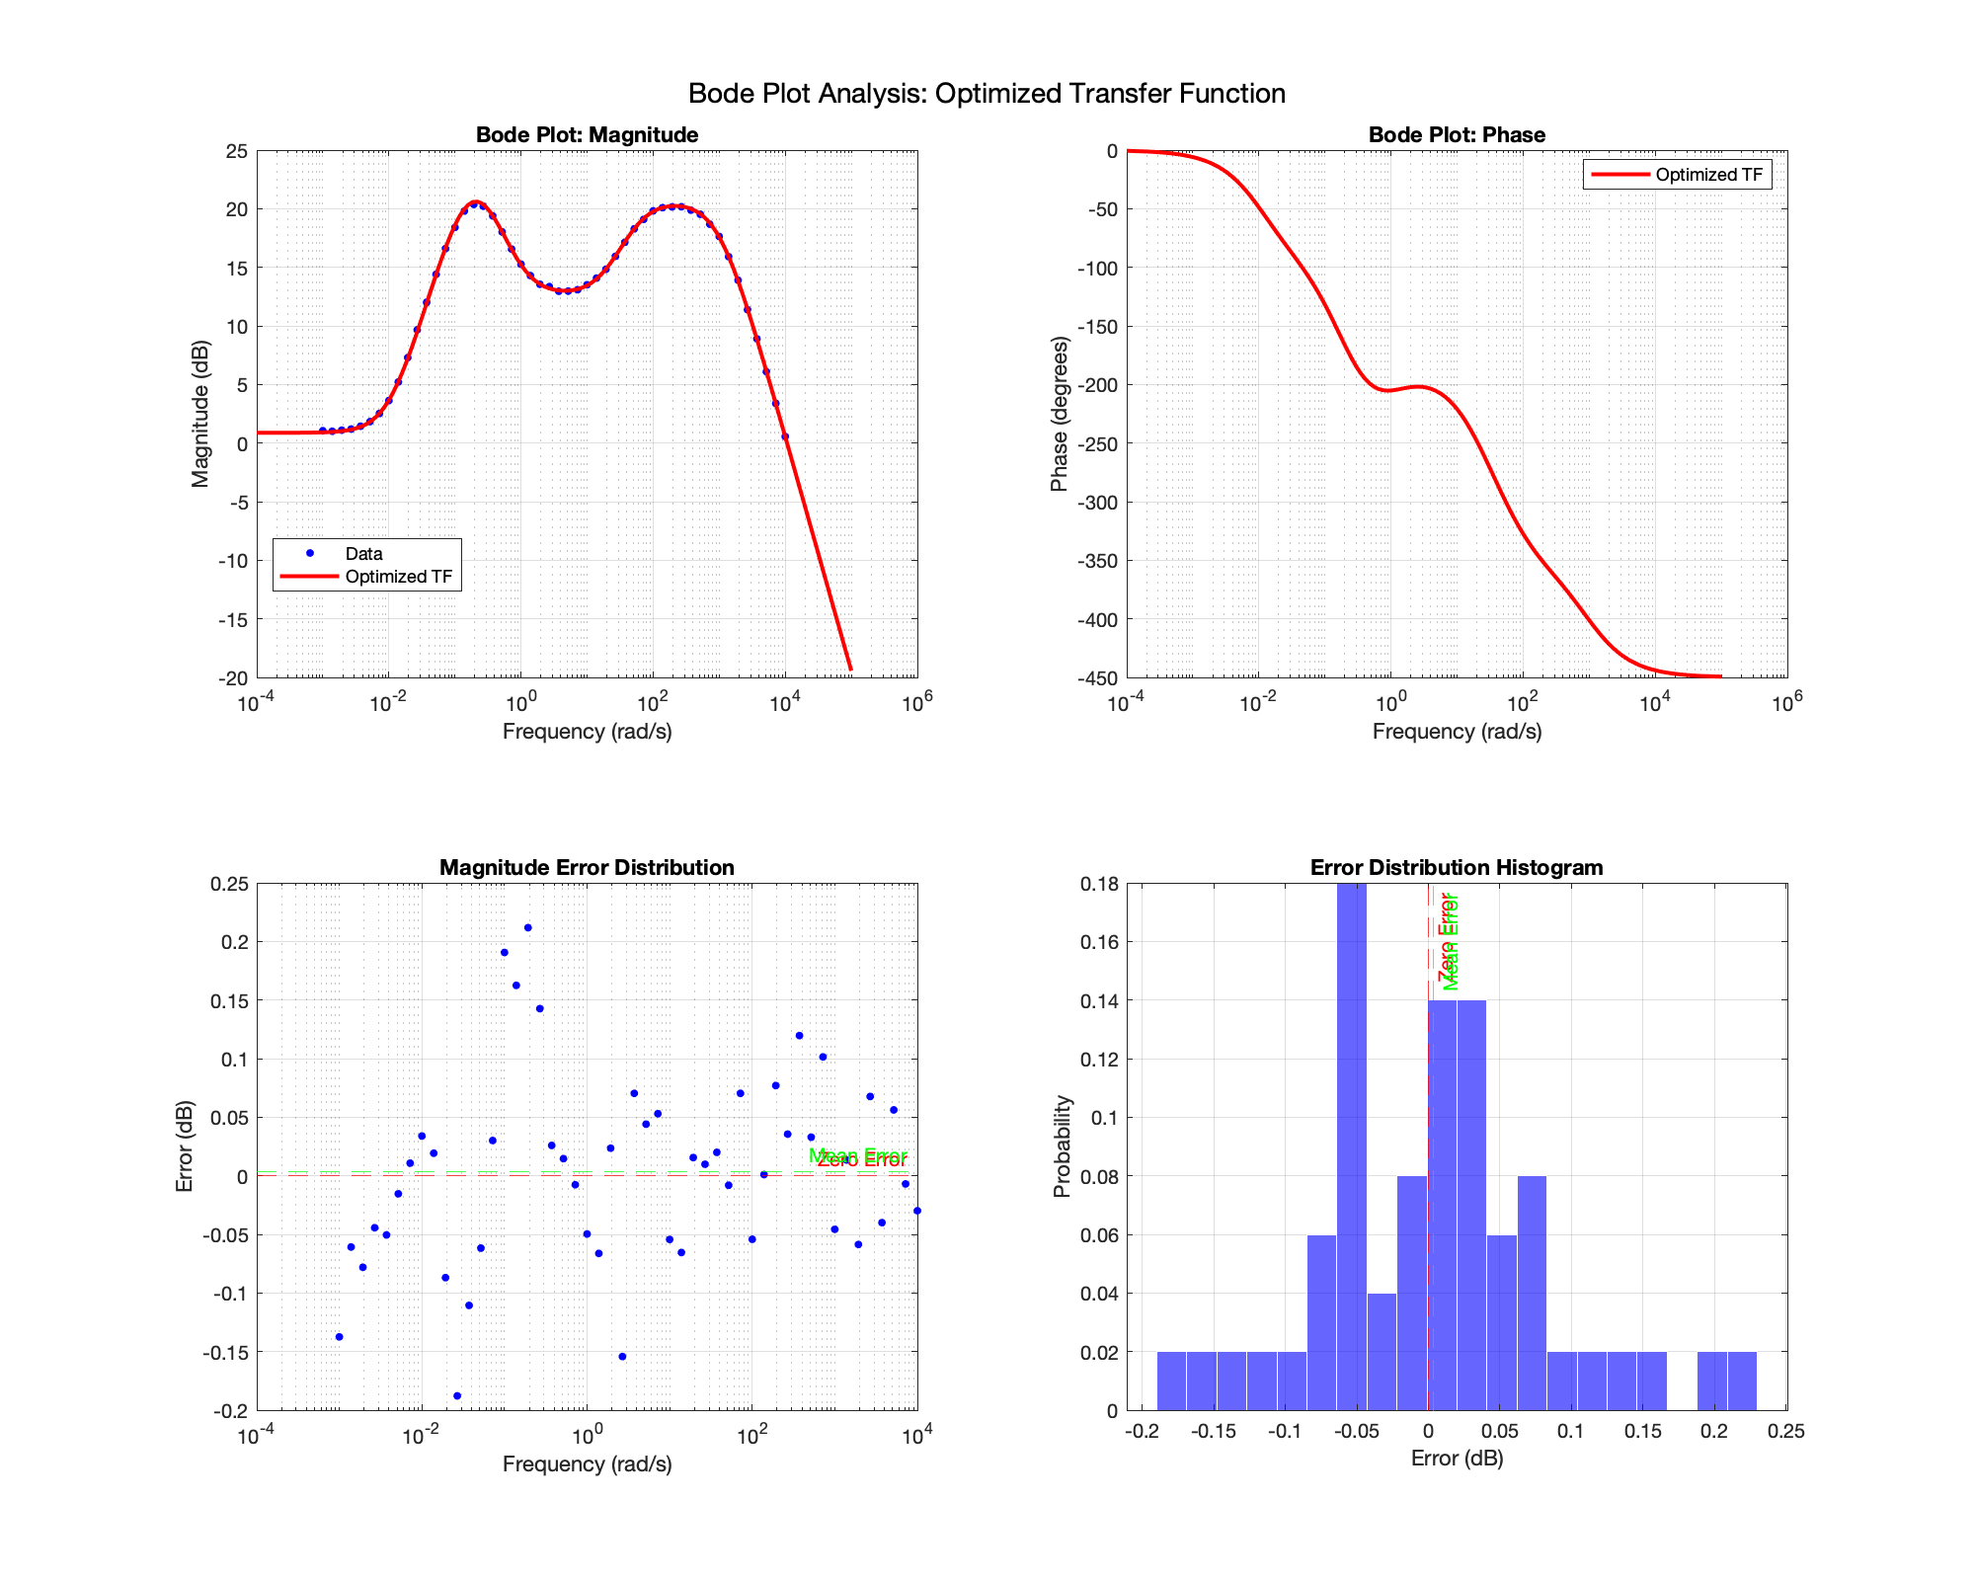
Bode Plot - Magnitude & Phase Response
Figure 7: Final Magnitude Bode Plot of the System
Notes:
Jack

Slide 14
Bode Plot - Transfer Function Error
Figure 8: Bode Plot Error Analysis
Notes:
Jack

Slide 15
Controller Design
PID controller tuned to stabilize roll motion.
Added Feedforward gain (L=4010) to move RHP zeros to LHP for stability
Simulated performance using step response analysis to hit system targets:
Metrics | Target | Idealized Transfer Function | System Transfer Function
Rise-Time(s) | 1 | 0.309s | 0.328s
Overshoot | 1.9 | 1.18 | 1.0052
Settling Time (s) | 3 | 2.25s | 0.58s-1.37s
Steady State Error | +-0.05 | 0.005 | 0.002
Table 1: System Target Performance
Notes:
Jack

Slide 16
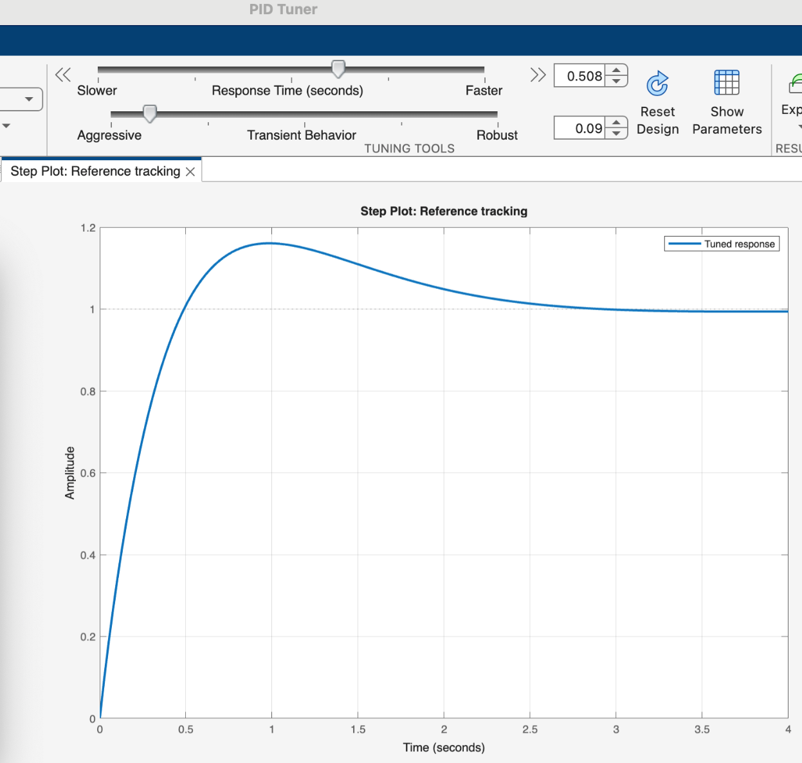
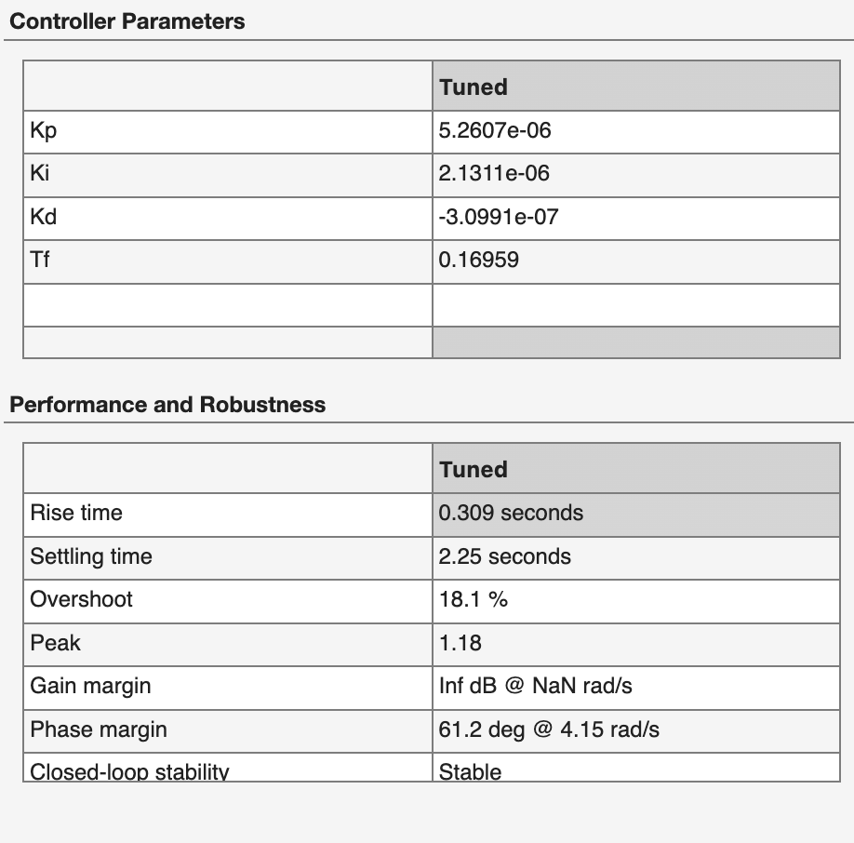
Controller Design - PID Tuner
Figure 9: Unit Step Response from Tuned PID on Transfer Function & Tuned PID Values

Slide 17
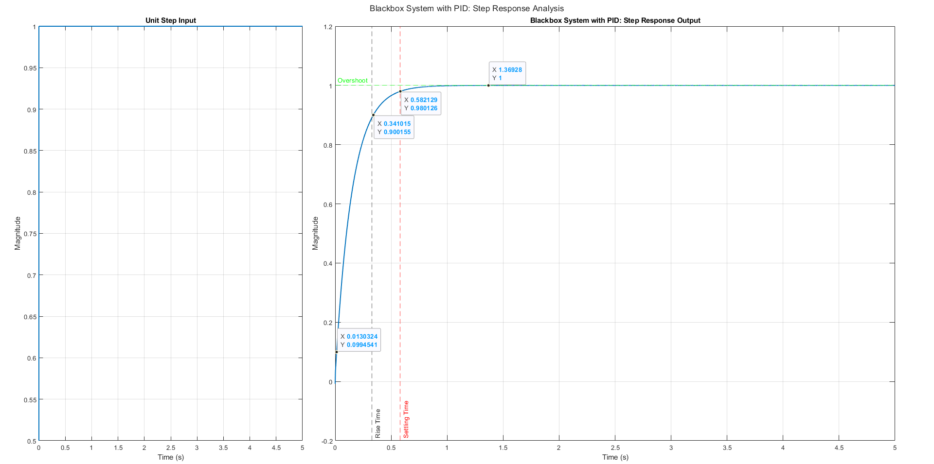
Blackbox with PID Control - Unit Step Input and System Step Response
Figure 10: Unit Step Response for Blackbox + PID Control
Notes:
Jack

Slide 18
Triple Bottom Line Analysis (Economic)
Impact | Key Benefits | Supporting Data
Economic | Reduces maintenance costs and improves fuel efficiency | Ship fuel consumption reduced by up to 10%, leading to annual savings of ~$200,000 per vessel (IMO, 2023)
 | Growing market demand for maritime autonomy | Maritime autonomous solutions market expected to grow at 7.5% CAGR from 2024 to 2030 (Allied Market Research, 2024)
International Maritime Organization (IMO), 2023. https://www.imo.org
Allied Market Research, 2024. https://www.alliedmarketresearch.com/maritime-autonomous-solutions-market
Notes:
Eiqan

Slide 19
Triple Bottom Line Analysis (Environmental)
Impact | Key Benefits | Supporting Data
Environmental | Reduces greenhouse gas emissions | Optimized stabilization can decrease CO₂ emissions by 8-12% per voyage (EMSA, 2022)
 | Supports global decarbonization efforts | The shipping industry contributes ~3% of global CO₂ emissions (IEA, 2023)
 | Minimizes marine pollution | Stabilization reduces excessive ship motion, preventing cargo spills
European Maritime Safety Agency (EMSA), 2022. https://www.emsa.europa.eu
International Energy Agency (IEA), 2023. https://www.iea.org
Notes:
Eiqan

Slide 20
Triple Bottom Line Analysis (Social)
Impact | Key Benefits | Supporting Data
Social | Enhances seafarer working conditions | 40% of maritime personnel experience motion sickness, impacting performance (Nautical Institute, 2023)
 | Improves maritime safety | Stability reduces the risk of accidents, lowering insurance claims and improving supply chain reliability (ILO, 2023)
Nautical Institute, 2023. https://www.nautinst.org
International Labour Organization (ILO), 2023. https://www.ilo.org
Notes:
Eiqan

Slide 21
Future Work, Considerations, and Improvements
Implement adaptive control techniques to enhance performance in varying sea conditions.
Conduct physical testing on scaled ship models for validation and performance assessment.
Develop a real-time monitoring interface for tracking and analyzing system behavior.
Refine the transfer function using real-world data to improve accuracy and reliability.
Notes:
Eiqan

Slide 22
Questions?
Notes:
Eiqan

Slide 23
Black-Box System Analysis and Control Design for Autonomous Ship Stabilization
MTHE 393 - Group 02
Nolan Verboomen, Jack Switzer, Elliott Thoburn & Eiqan Ahsan
Notes:
Eiqan

